Slide 1
GrowSmart
An ML based Intelligent recommendation system for crops and fertilizers
Under the Guidance of
Mrs. S. Kusuma
By
R M Sai Mohit (19699A0544)
M Madhusudhan (19699A0524)
B Jagadeesh (19699A0517)
K V Hari Prasad (19699A0513)
Computer Science and Engineering
Madanapalle Institute of Technology and Science
Andhra Pradesh

Slide 2
CONTENTS
Abstract
Problem Definition
Objectives
Existing System
Proposed System
Literature Survey
Architecture
Algorithms Used
Feasibility
Requirements
References

Slide 3
ABSTRACT
Agriculture is a major source of income and employment in India. The most prevalent problem faced by Indian farmers is that they do not select the appropriate crop for their land and do not use the appropriate fertilizer. They will experience a significant drop in production as a result of this. GrowSmart has been used to solve the farmers difficulties. GrowSmart is a modern farming strategy that employs research data on soil properties, soil types, and crop yield statistics to recommend the best crop to farmers as well as fertilizer recommendations. This decreases the number of times a crop is chosen incorrectly and increases productivity. The aim of this analysis is to develop a system which helps the farmers to recommend a crop for the site specific parameters with high accuracy and efficiency with the help Machine Learning (ML) approaches.

Slide 4
PROBLEM DEFINATION
In India, agriculture is one of the most important professions. Many of the people do agriculture but are unable to determine which types of crops are more suitable to their soil. Means there are variety of crops which are only suitable for wet soil, some requires medium humidity in the soil to grow but this knowledge is less known to farmers as well as newbies who develop some interest in farming. As of now there are very less resources as well as software’s which will help them to improve quality. Such type of software is “GROWSMART”.

Slide 5
OBJECTIVES
To build a robust model to provide correct and accurate prediction of crop sustainability in a given state for the particular soil type and climatic conditions.
To build user friendly and interactive application.
Provide recommendation of the most effective suitable crops within the area in order that the farmer doesn't incur any losses.
Provide fertilizer suggestion for crops supported chemical features.

Slide 6
EXISTING SYSTEM
Existing system are restricted to few algorithms only.
Highest accuracy of existing system is Random Forest - 75% and CNN-95.21%
The User alone can see the crops that are recommended based on the input.
Existing system uses only few parameters.

Slide 7
PROPOSED SYSTEM
We are going to use 7 best machine learning algorithms and we will take the best algorithm for recommendations.
After finding the highest accuracy algorithm that is used for testing new data.
New data is entered using Web Interface and it will recommend the crops based on the input and provides suggestions.
The user can visit fertilizer store and read blogs regarding the Agriculture.
The user can see the statistical analysis and visuals of crop production in recent years.

Slide 8
LITERATURE SURVEY
AUTHOR | YEAR | TITLE | SOURCE | METHODOLOGY USED
Aditya Param Patil Vatsa Nagaria Shobhit Sunil Ghane | 2022 | Soil Analysis and Crop Recommendation using Machine Learning | www.ieee.org (Institute of Electrical and Electronics Engineers) | CNN Random Forest
Daneshwari Ashok V Vijayalaxmi Anupama | 2022 | Crop Recommendation Using Machine Learning Algorithm | www.ieee.org (Institute of Electrical and Electronics Engineers) | SVM
Soham Chakraborty Sushruta Mishra | 2022 | A Smart Farming-Based Recommendation System Using Collaborative Machine Learning and Image Processing | Springer | XGboosting Naive Bayes KNN Random Forest

Slide 9
LITERATURE SURVEY
AUTHOR | YEAR | TITLE | SOURCE | METHODOLOGY USED
Shilpa prem kumar anmol anmol aishwarya karuna rohilla Kumar shaurya | 2021 | Crop Recommender System Using Machine Learning Approach | www.ieee.org (Institute of Electrical and Electronics Engineers) | SVM Random Forest KNN Linear Regression
Shariff Shwetha R B Ramya O G Pushpa H Pooja K R | 2022 | Crop Recommendation using Machine Learning Techniques | www.ijert.org (International journal of engineering research & technology) | Decision Tree Naïve Bayes Gradient Boosting KNN Random Forest
Abhinav Sharma Muskaan Bhargava Akshay Vijay | 2022 | AI-Farm: A crop recommendation system | www.ieee.org (Institute of Electrical and Electronics Engineers) | Decision tree Naive Bayes Logistic Regression Random Forests

Slide 10
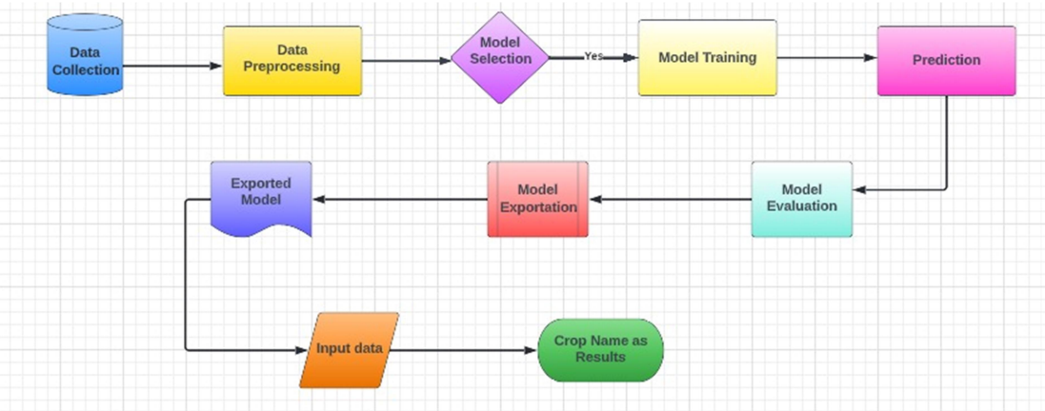
ARCHITECTURE

Slide 11
ALGORITHMS USED
Logistic Regression
K Nearest Neighbours
Random Forest
Support Vector Machine
Naive’s Bayes Algorithm
Decision Tree
Gradient Boosting

Slide 12
FEASIBILITY
N: ratio of Nitrogen content in soil
P: ratio of Phosphorous content in soil
K: ratio of Potassium content in soil
Temperature: temperature in degree Celsius
Humidity: relative humidity in %
pH: pH value of the soil
rainfall: rainfall in mm

Slide 13

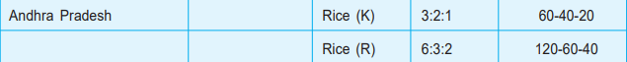
CROP RESPONSE AND NUTRIENT RATIO POLICY
NAAS(National academy of agricultural sciences) published a policy containing the NPK ratio for various crops across the India.

Slide 14
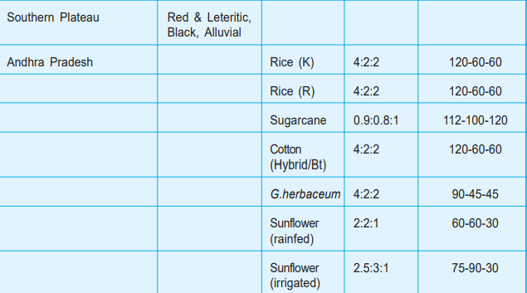
CROP RESPONSE AND NUTRIENT RATIO POLICY

Slide 15
REQUIREMENT SPECIFICATION
HARDWARE REQUIREMENTS
RAM: 8GB/16GB for faster output
Hard Disk: 1TB
Micro Processor: 2.0 GHz
Micro Processor: Core i5/core i7
Any Desktop or Laptop systems with high level configuration
SOFTWARE REQUIREMENTS
OS (Operating Systems): Windows 10/11
Programming Language: Python, HTML, CSS
Platform: Pycharm, Jupyter NoteBook
Libraries: NumPy, Pandas, Sklearn, Flask
Database: MySQL

Slide 16
REFERENCES
[1] Aditya, Param Patil, Vatsa Nagaria, Shobhit , Sunil Ghane’s “Soil Analysis and Crop Recommendation using Machine Learning” in Institute of Electrical and Electronics Engineers(IEEE) in 2022.
[2] Daneshwari ,Ashok V, Vijayalaxmi Anupama’s “Crop Recommendation Using Machine Learning Algorithm” in Institute of Electrical and Electronics Engineers(IEEE) in 2022.
[3] Shilpa, prem kumar , anmol anmol, Aishwarya,karuna rohilla, Kumar shaurya’s “Crop Recommender System Using Machine Learning Approach” in Institute of Electrical and Electronics Engineers(IEEE) in 2021.

Slide 17
REFERENCES
[4] Soham Chakraborty and Sushruta Mishra’s “A Smart Farming-Based Recommendation System Using Collaborative Machine Learning and Image Processing” in Springer in 2022.
[5] Shariff, Shwetha R B, Ramya O G, Pushpa H, Pooja K R’s “Crop Recommendation using Machine Learning Techniques” in International journal of engineering research & technology ICEI – 2022 (Volume 10 – Issue 11) in 2022.
[6] Abhinav Sharma, Muskaan Bhargava, Akshay Vijay’s “AI-Farm: A crop recommendation system” in Institute of Electrical and Electronics Engineers(IEEE) in 2022.

Slide 18
REFERENCES
[7] R. Kumar, M.P. Singh, P. Kumar and J.P. Singh, “ Crop Selection Method to Maximize Crop Yield Rate using Machine Learning Technique,” in Proc. 2015 Int. Conf. Smart Technol. and Manage. for Comput., Commun., Controls, Energy and Mater.
[8] A. T. M. S. Ahamed et al., “Applying data mining techniques to predict annual yield of major crops and recommend planting different crops in different districts in Bangladesh,” in Proc. 2015 IEEE/ACIS 16th Int. Conf. Soft. Eng., Artif. Intell., Netw. and Parallel/Distrib. Comput.
[9] M. Paul, S.K. Vishwakarma and A. Verma, “Analysis of Soil Behaviour and Prediction of Crop Yield using Data Mining Approach,” in Proc. 2015 Int. Conf. Comput. Intell. and Commun. Netw.

Slide 19
THANK YOU

